Slide 1
BDAT 1004 DATA PROGRAMMING Final Project, Group 7 – Bitcoin Analysis
Pravneet Singh, Pushkar Rawat, Harleen Kaur, Gurleen Bhullar

Slide 2




Our Team
Pravneet Singh
Project Manager
Pushkar Rawat
Developer
Gurleen Bhullar
Data Analyst
Harleen Kaur
Business Analyst

Slide 3

Contents
Project Summary
Project Aim
Data source – API
MongoDb
Website Development – Flask
Data Visualization
Fit Gap Analysis

Slide 4

Project Summary
We have used an API from a remote data source on Bitcoin rates:
https://www.alphavantage.co/query?function=DIGITAL_CURRENCY_DAILY&symbol=BTC&market=CAD&apikey=451KU60FV4BXH04K
Python was used to retrieve the entire data from the API and store the same into a cloud database – MongoDb
We have used a pseudo batch process written in Python to update the database that runs every 24 hours
The Web application was created and built using Python on Visual Studio Code
HTML, CSS, and Javascript were used for the front end development of the site and for charts
Finally, a Fit Gap Analysis was conducted to analyze future trends

Slide 5
What is the Project Aim?
A client has asked to build a proof of concept "Web" application to demonstrate our abilities as a team/company. They are prepared to contract the team for several years however, they have many other bids to review.
So, the project is built to –
Demonstrate acquisition of data from a URL
Use Python to store it into a cloud database
Run a pseudo batch process that runs every 24 hours
Create a Web App to show the results using Flask or Django
Create charts using charts.js to visualize data
Conduct a fit gap analysis

Slide 6
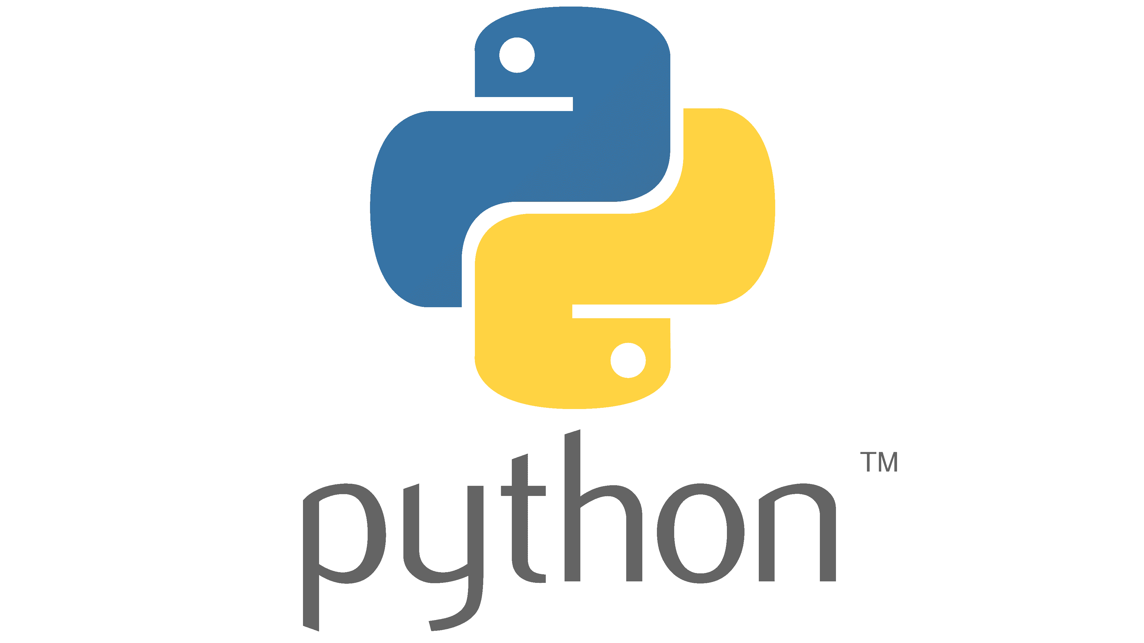


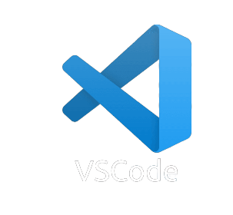
Tools Used
Python
Python Web Framework – Flask
Cloud NoSQL – MongoDb
Visual Studio Code
HTML
CSS
Javascript

Slide 7
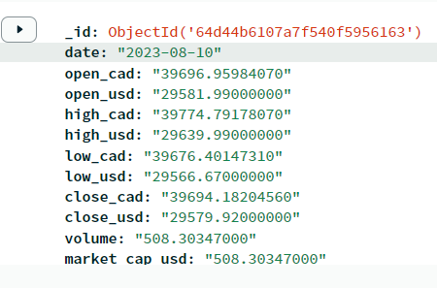
Data Source - API
The data source we have used is on Bitcoin
Our aim is to analyze rates of Bitcoin daily be it in CAD or USD – on the opening and closing hours
The screenshot on the right shows the various entities present in the API which will be used for analysis

Slide 8

Project Scope
Data acquisition from remote URL
Creating Website using Flask Framework
Building an API that serves from live cloud database
Creating Dashboard Visualization using chart.js
Storing data in Mongo DB

Slide 9
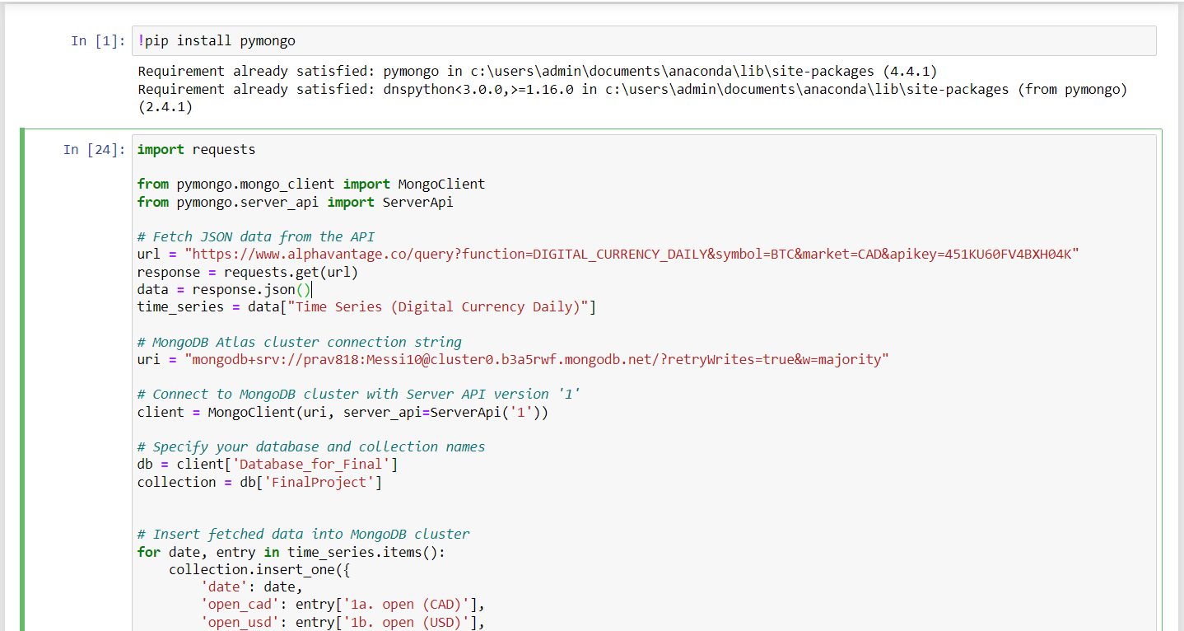
Python Code Used for fetching data from API and storing the same into MongoDb

Slide 10
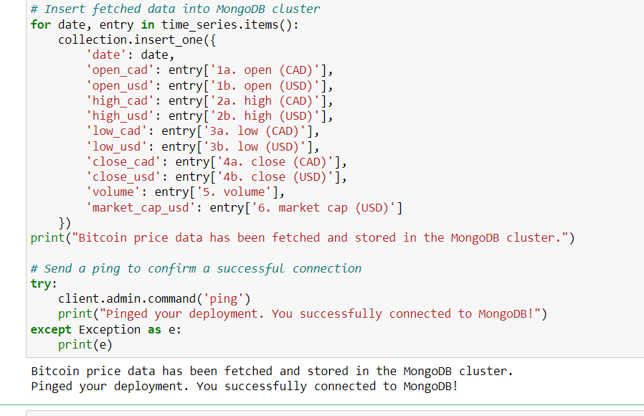

Slide 11
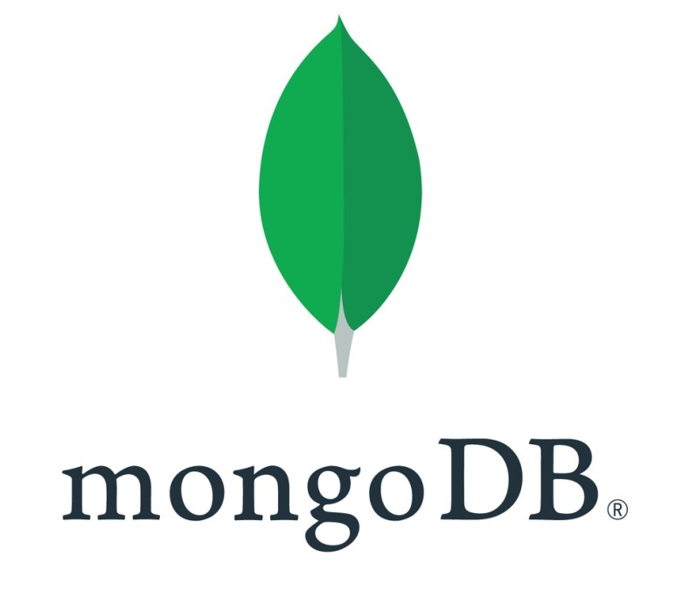
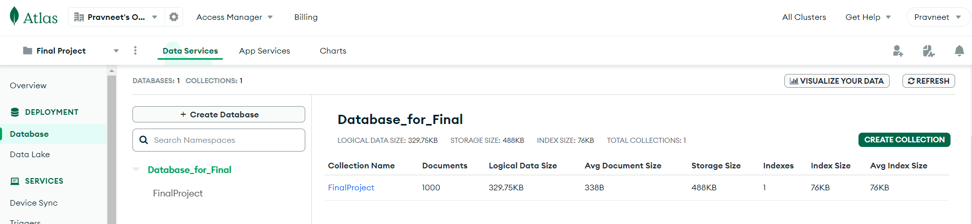
MongoDb Database and Collection
Database – Database_for_Final
Collection- FinalProject

Slide 12
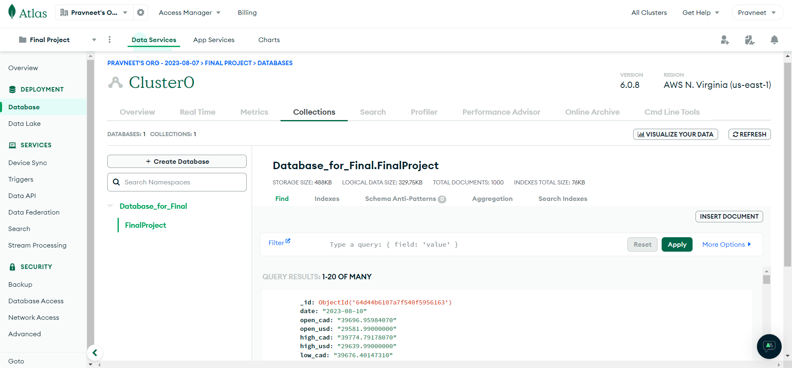
MongoDb Collection

Slide 13
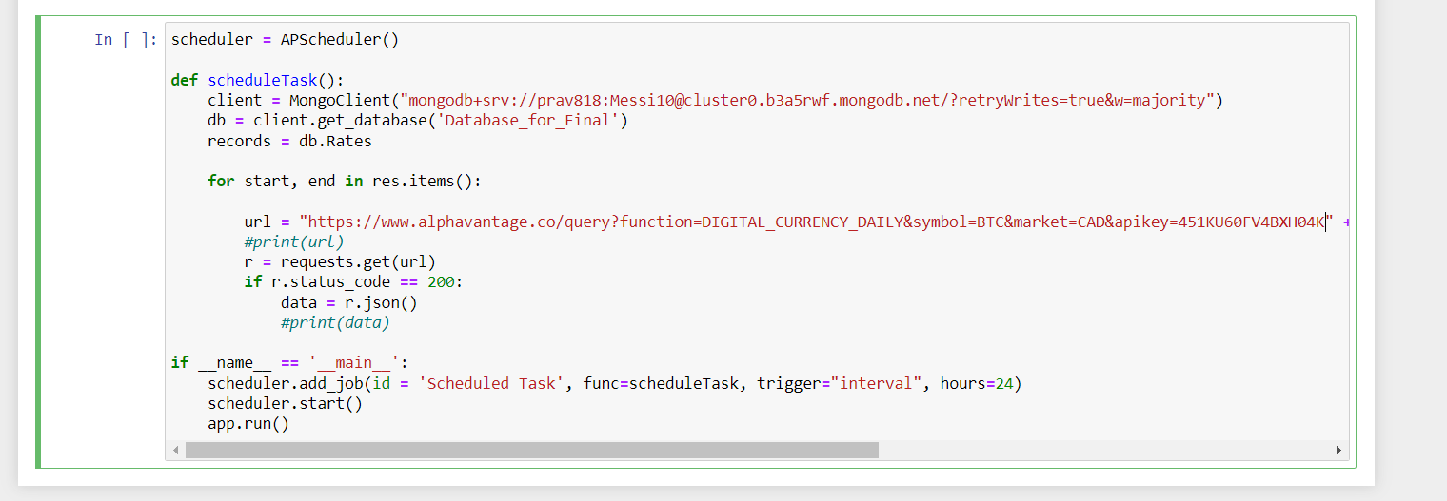
Pseudo Batch Process to acquire data every 24 hours

Slide 14
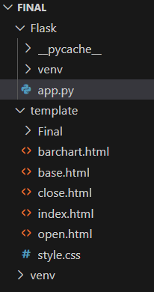
Flask – Web App Development via VS Code
We have used Flask as a web app development framework from Python using Visual Studio Code
The screenshot on the right shows the main app.py python file to launch the main web app along with the various html pages to launch the visualisations that include code from HTML, CSS, and JavaScript

Slide 15
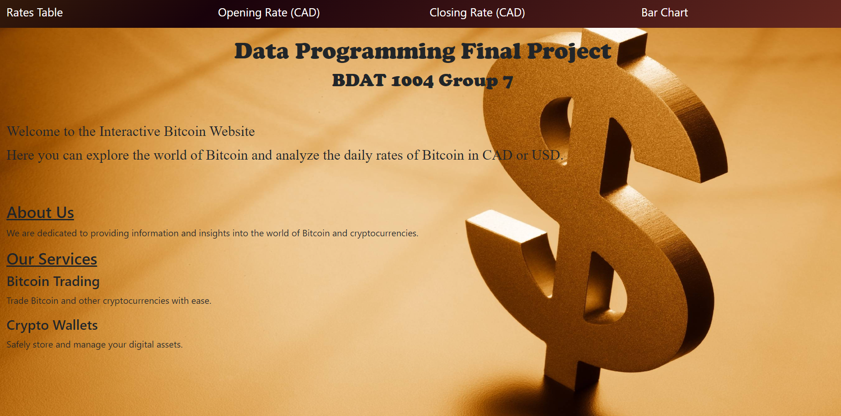
Website Home Page

Slide 16
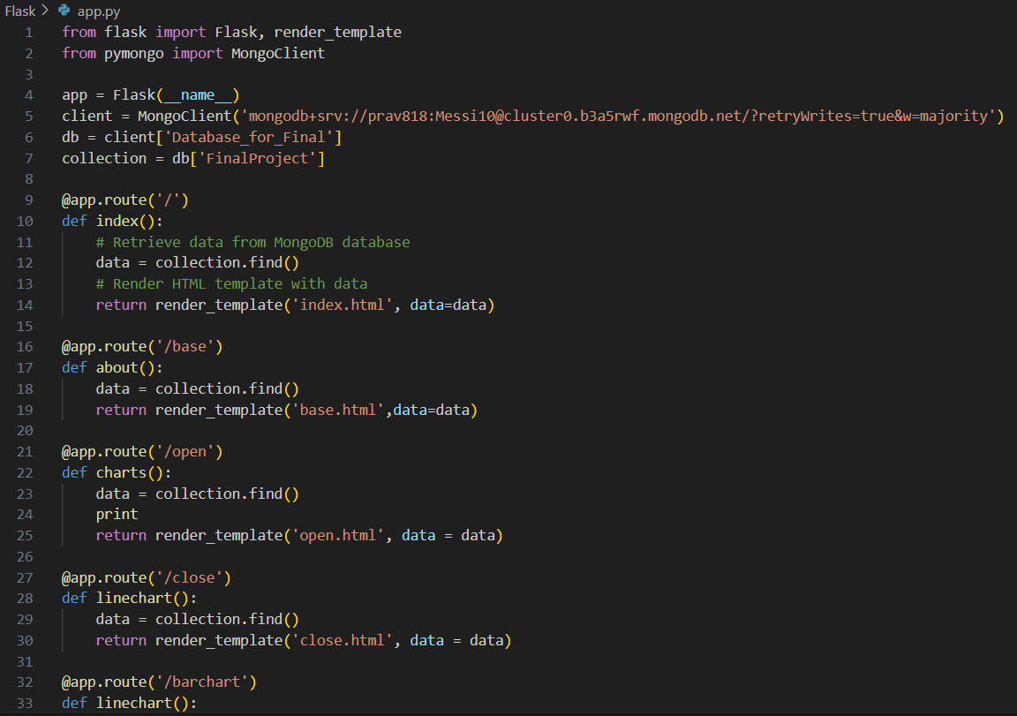
The Previous Home Page was launched with this code

Slide 17
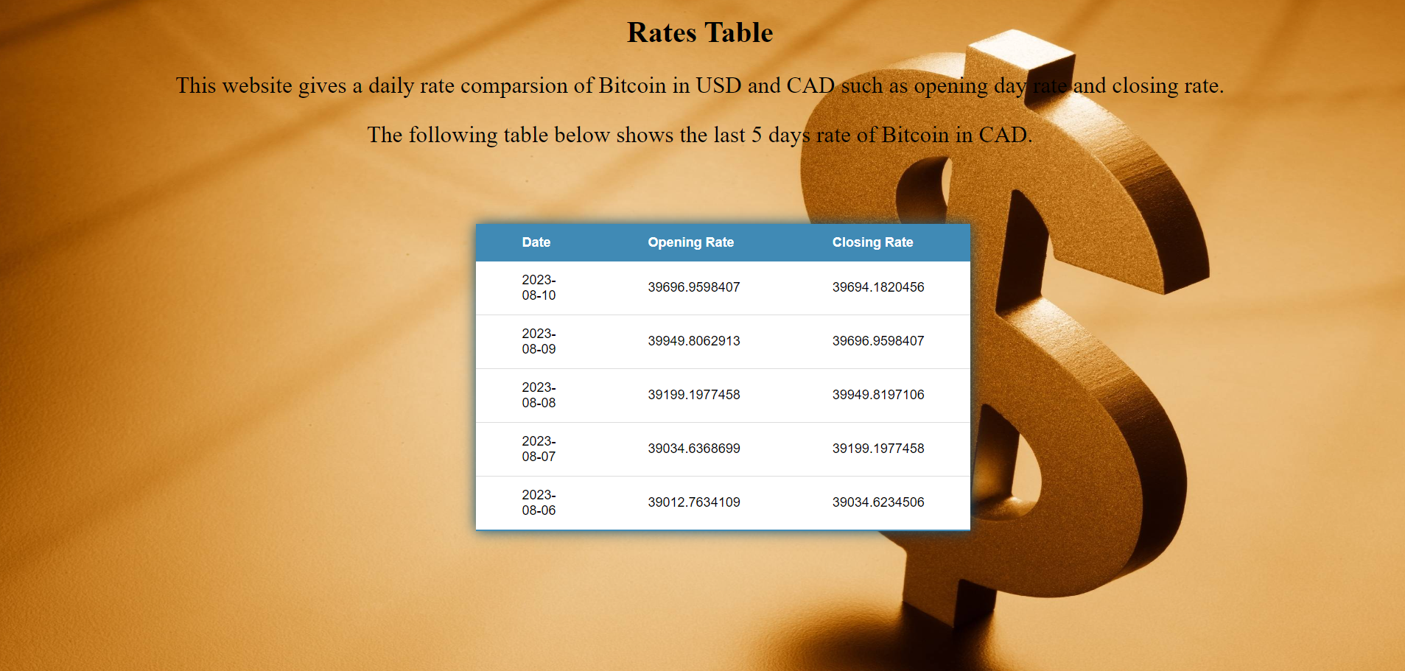
Table to show Last 5 days Bitcoin rate in CAD

Slide 18
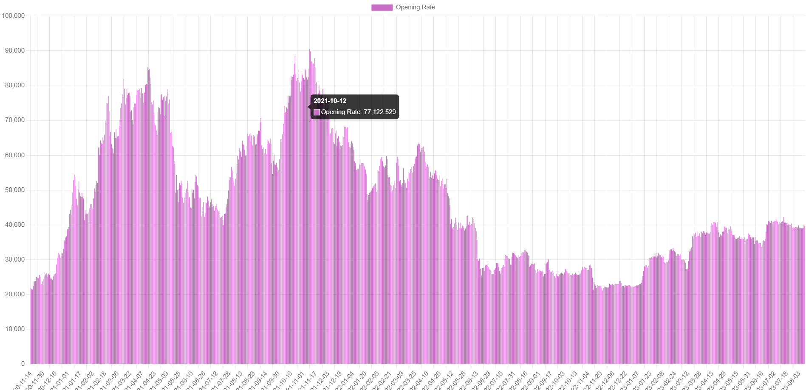
Bitcoin Opening Rates in CAD – last 3 years

Slide 19
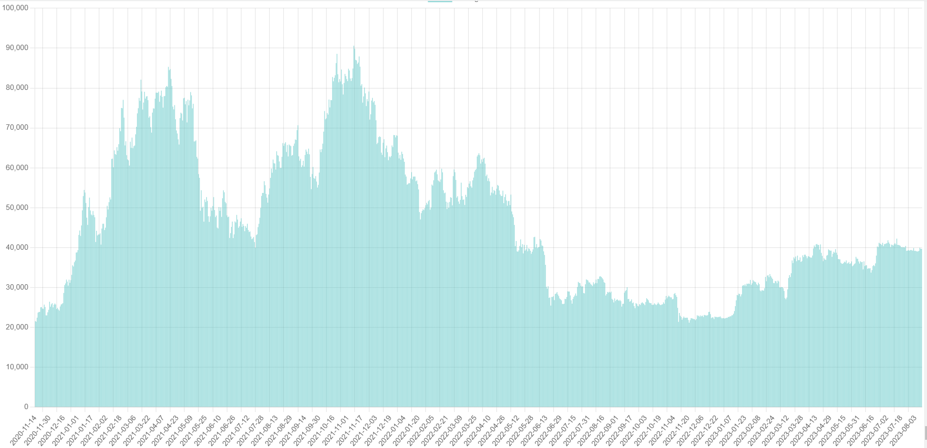
Bitcoin Closing Rates in CAD – last 3 years

Slide 20
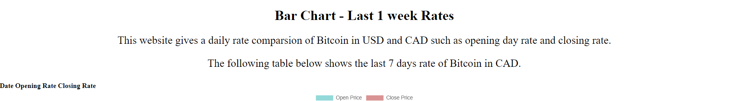
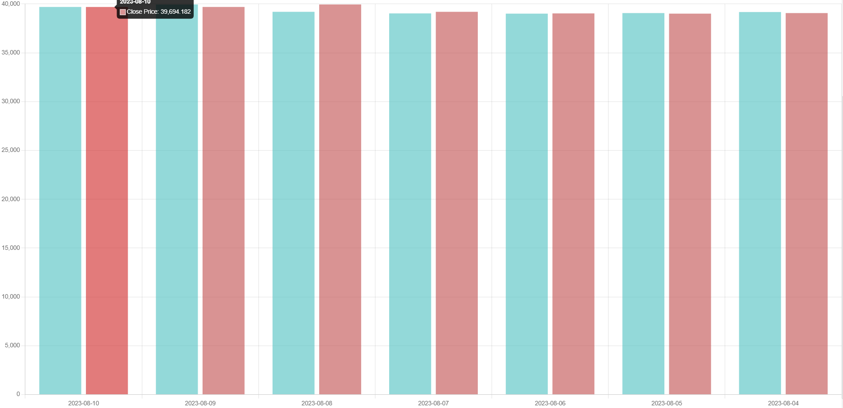
Bar Chart to compare the opening and closing rates in CAD – to analyse daily fluctuations

Slide 21
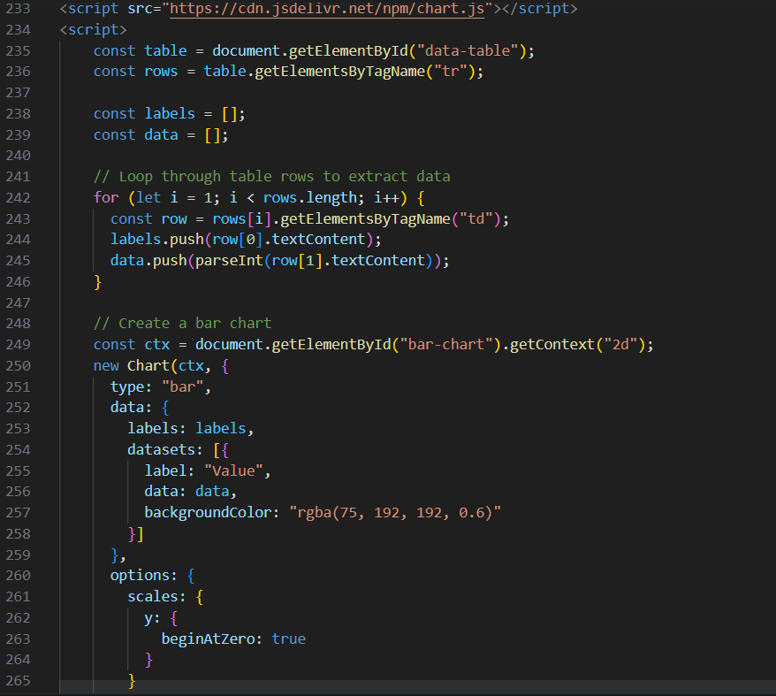
Codes from VS Code for reference apart from LIVE demonstration
Code to create a basic chart used to create the charts we used
This is the comparison chart for the opening and closing rates of Bitcoin for the last one week

Slide 22
Fit Gap Analysis
More accurate data from a larger population and timeframe could be used
Various different visualizations apart from the ones we used could show more in-depth analysis
Apart from the comparison of rates, we could also touch upon prices in different markets, volume of Bitcoin, reasons as to why a dip or hike incurred at that time, as well as comparisons to other cryptocurrency such as Dogecoin
To give a user a more hands on UI, we could also add drop downs for filtering

Slide 23

Thank You!

